Slide 1

Programação WEB

Slide 2



www.google.com.br
DNS
172.217.162.99
SERVIDOR

Slide 3


Front-End
Back-End
HTML
CSS
Javascript – NÃO É JAVA!!!!
JAVA
C#
Python
PHP
NodeJS (Javascript)

Slide 4












Slide 5
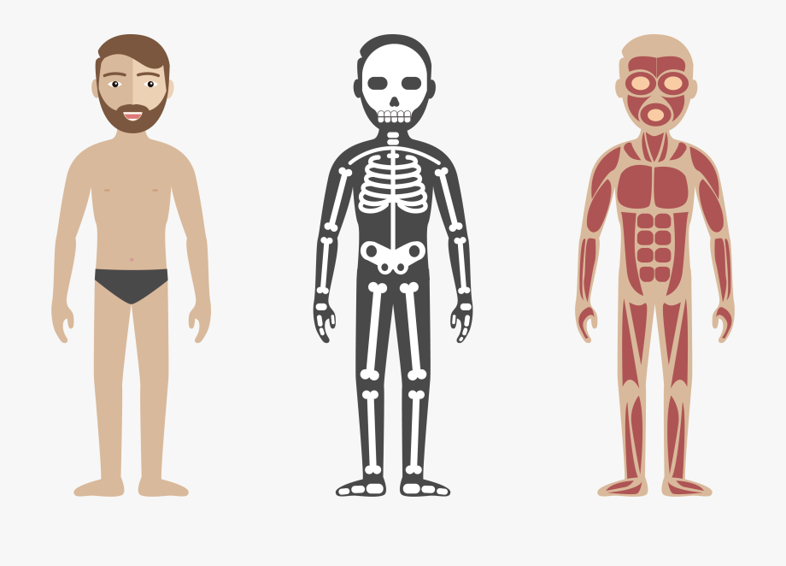
CSS
HTML
JS

Slide 6
BODY
NAV
DIV
A
HEADER
H1
ARTICLE
ARTICLE
ARTICLE
H2
H2
H2
P
P
P

Slide 7
Links Úteis
https://www.w3schools.com/
https://unsplash.com/
https://fonts.google.com/
https://icofont.com/
https://webgradients.com/
https://www.awwwards.com/
https://undraw.co/
https://developer.mozilla.org/pt-BR/docs/Web/HTML/Element
Google: color picker

Slide 8


